Slide 1


Titolo presentazione sottotitolo
Degree course:
Computer Science and Engineering
Milano, XX mese 20XX
Project of Complessità nei sistemi e nelle reti
Balestrieri Niccolò Milan, 7 March 2023

Slide 2

Context and objective of the project activity
Analysis of a directed graph in the field of 2004 USA politcs elections, using the tools provided during the course
Considerations on the results obtained

Slide 3

Dataset
Two different datasets were used, provided by the konect website:
Directed graph in csv format, representing a directed network contains front-page hyperlinks between blogs in the context of the 2004 US election.
CSV file containing the list of all nodes and their political orientation
To carry out the analysis on the network, various operations were carried out on the two datasets

Slide 4
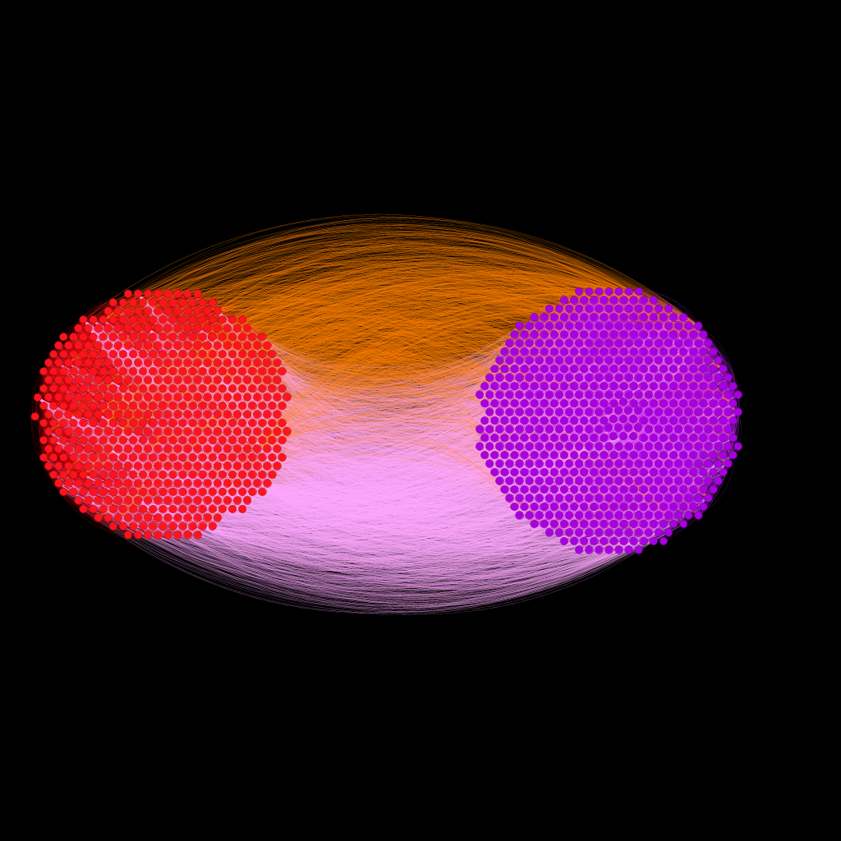
Dataset
Comparing myself with the analyzes and results obtained from the following paper:
“Lada A. Adamic and Natalie Glance. The political blogosphere and the 2004 US election: Divided they blog. In Proc. Int. Workshop on Link Discov., pages 36–43, 2005.”
I thought it appropriate to represent the following graph, which with another layout, is represented in the paper
Red nodes are the liberal blogs while the purple nodes are the democratic blogs
Orange edges are hyperlinks between liberal-democratic, while pink edges are hyperlink between democratic-liberal

Slide 5
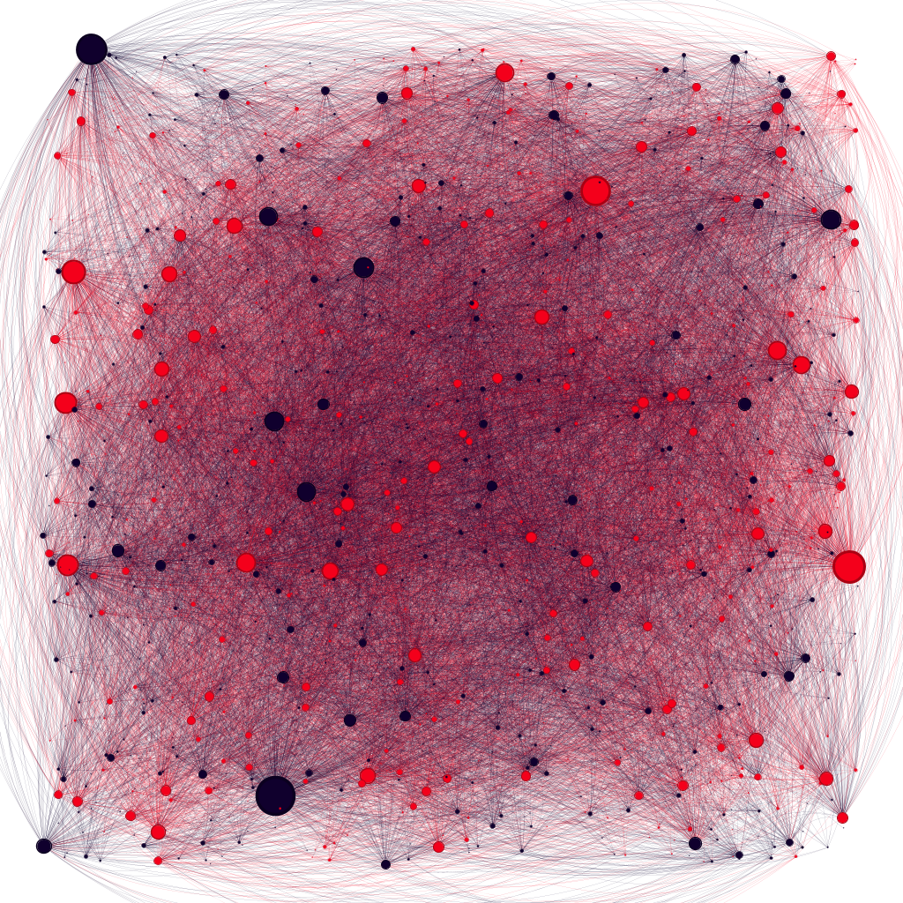
Network properties
This network has:
1224 nodes
19025 egdes
This is a direct network so the degree is divided into:
In- degree
Out- degree
Total degree

Slide 6
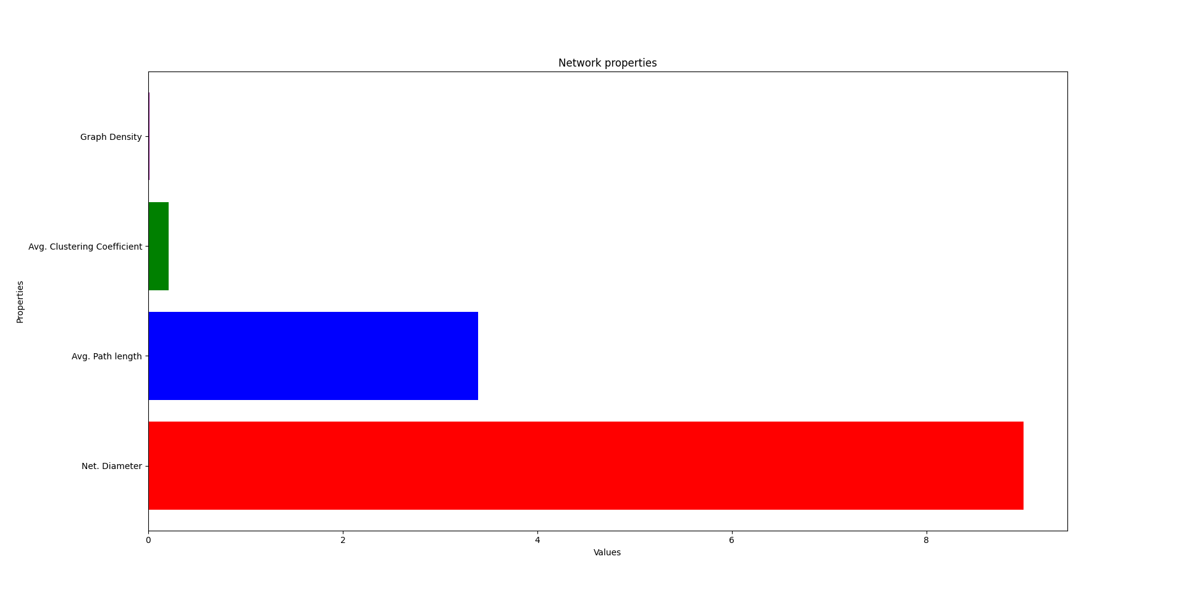
Network properties
A connected network has several properties:
The network diameter is equal to 9
The Average Path length is equal to 3,390
The Average Clustering coefficient is equal to 0,210
The Graph Density is equal to 0,013

Slide 7
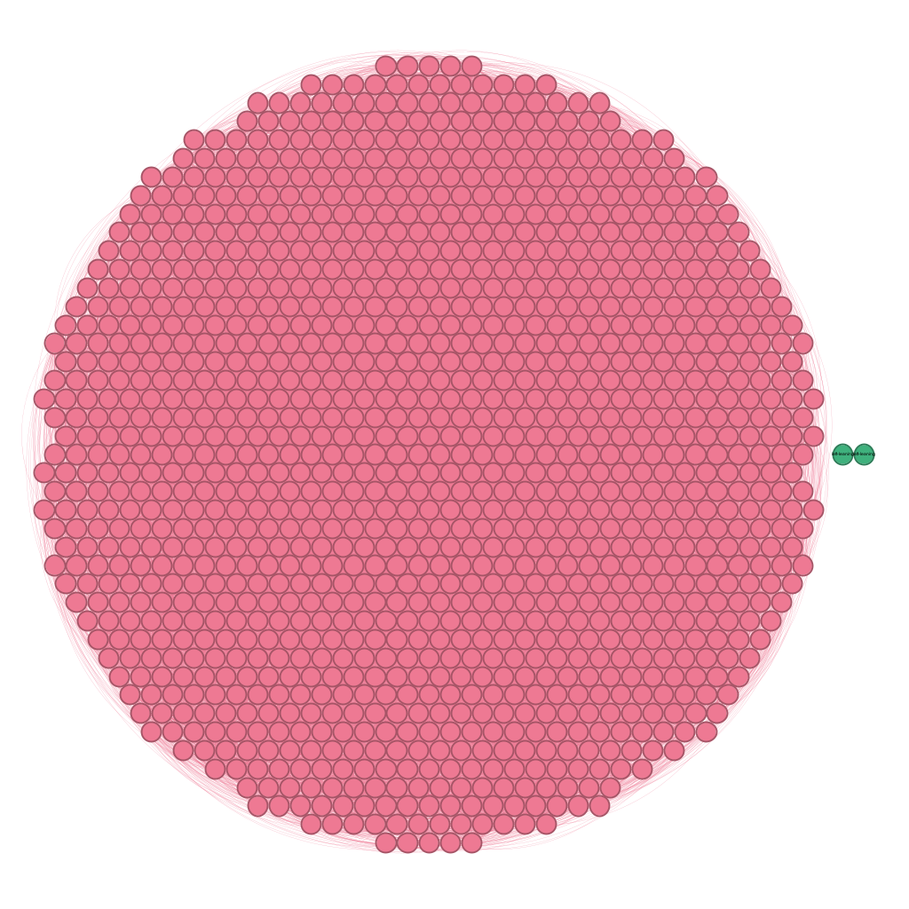
Components
In this case, given that it is a direct network, I calculated the number of the strongly connected components and of the weakly connected components:
SCC = 422
WCC = 2
Pink = SCC
Green = WCC

Slide 8
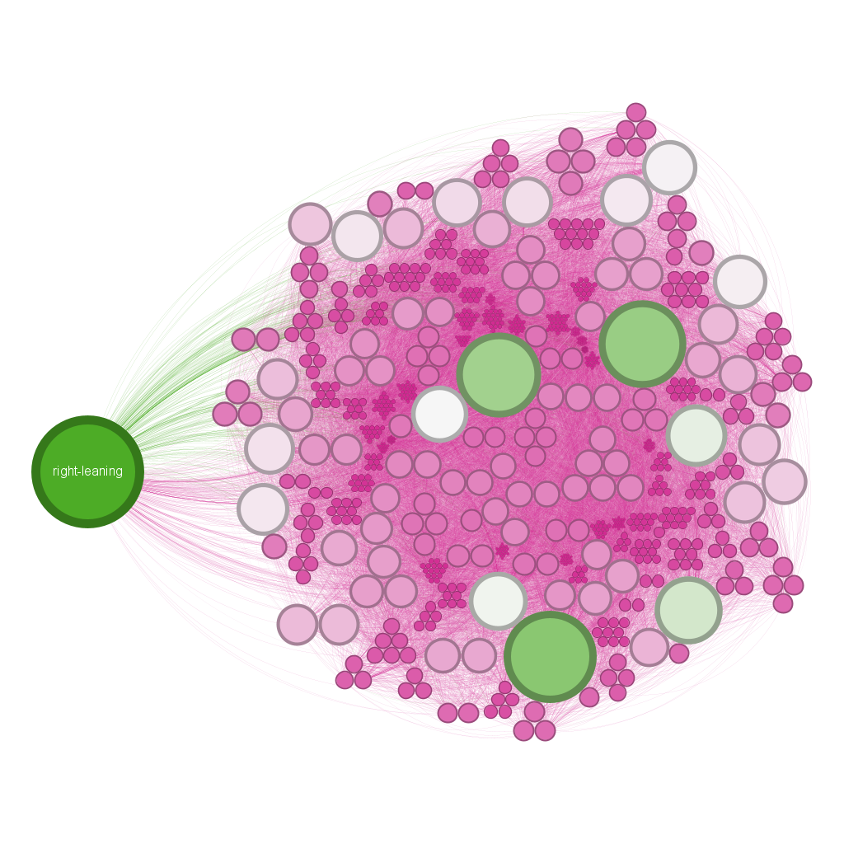
Network properties
The green node is the one with the highest average degree, 467
The average degree is equal to 15,543

Slide 9
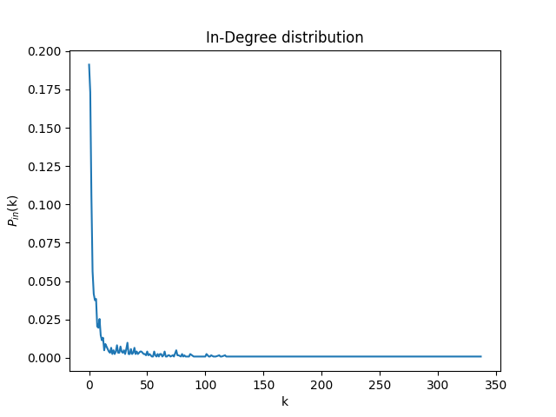
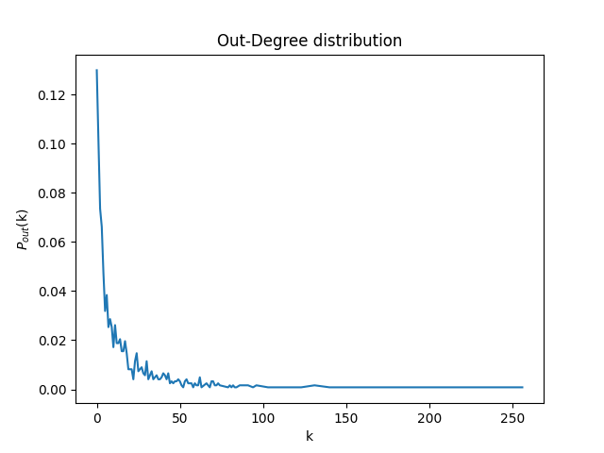
Network properties
I decided to calculate the In- and Out- degree distributions and plot it all
In-degree distribution
Out-degree distribution

Slide 10
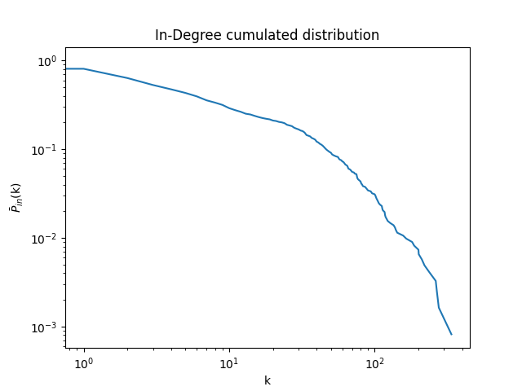
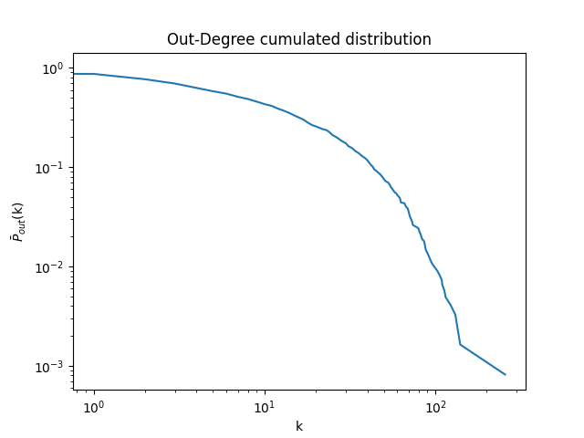
Network properties
Then, i also calculate the In- and Out- degree cumulated distributions and plot it all
In-Degree cumulated distribution
Out-Degree cumulated distribution

Slide 11
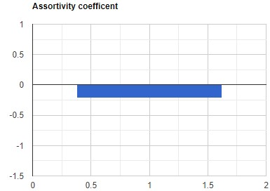
Network properties
To establish if the network was correlated, I decided to calculate the assortivity coefficient
The assortivity coefficient is equal to
-0,210
Network is disassortative

Slide 12
Network model
Scale free

Slide 13
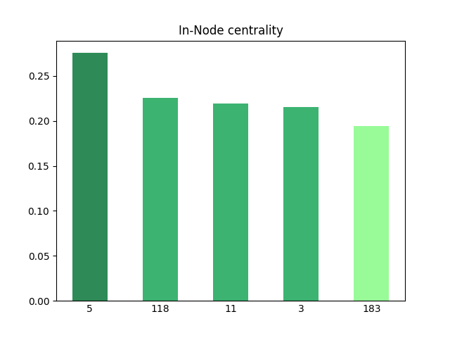
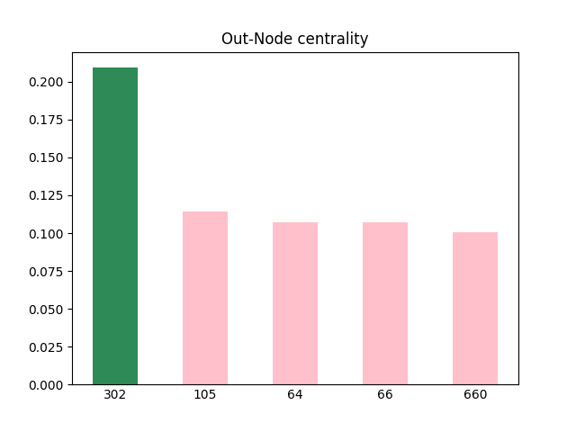
Centralities
Node Centrality

Slide 14
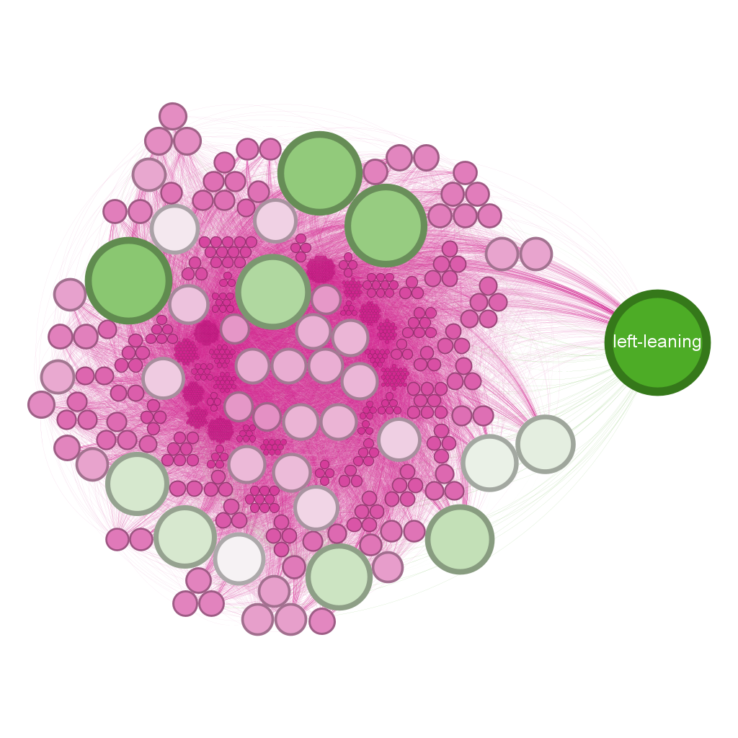
Network properties
The green node is the one with the highest In-Degree
That Degree is equal to 337

Slide 15
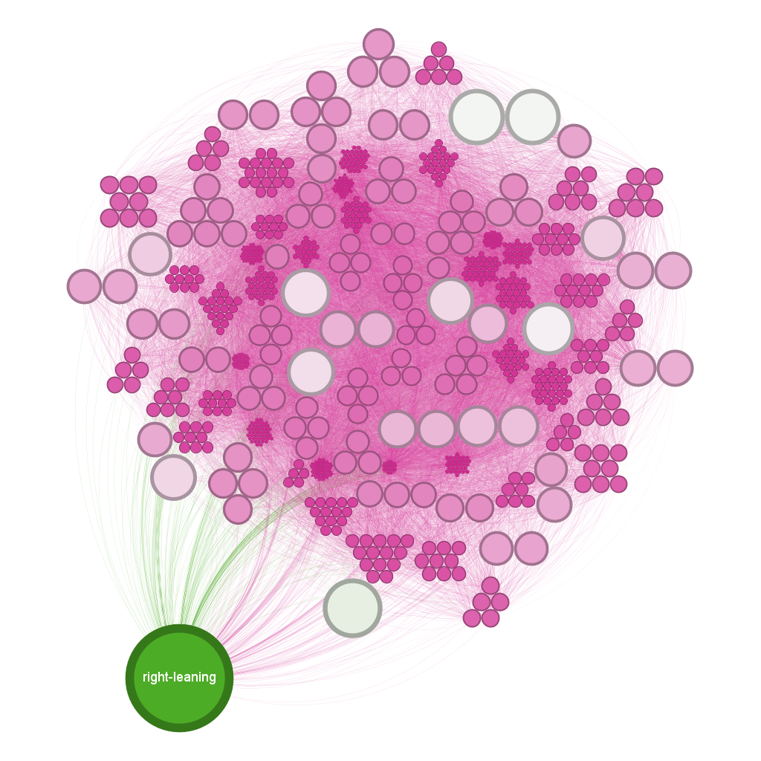
Network properties
The green node is the one with the highest Out-Degree
That Degree is equal to 256

Slide 16
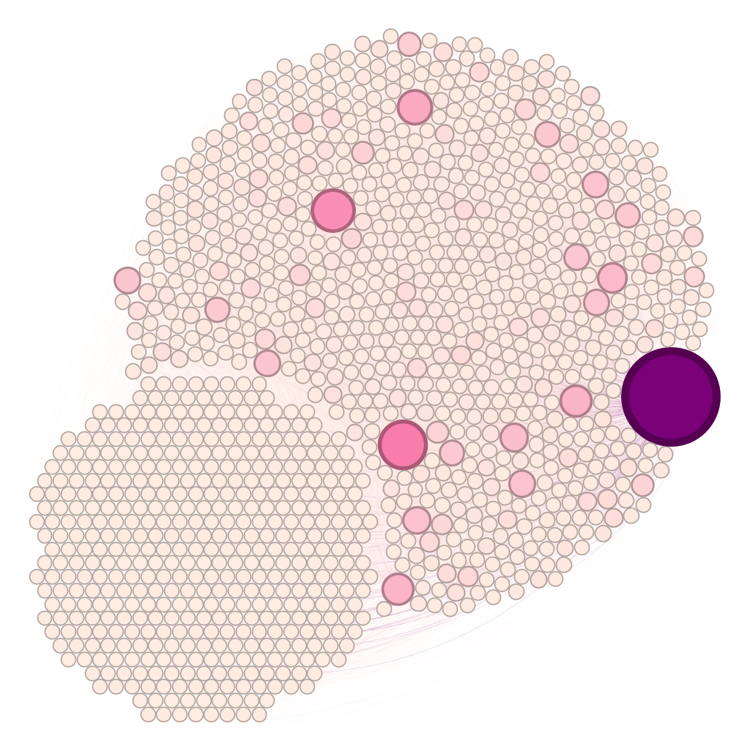
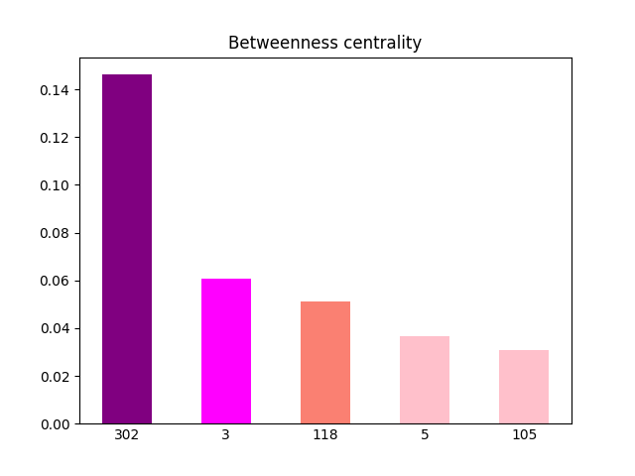
Centralities
Betweenness centrality

Slide 17
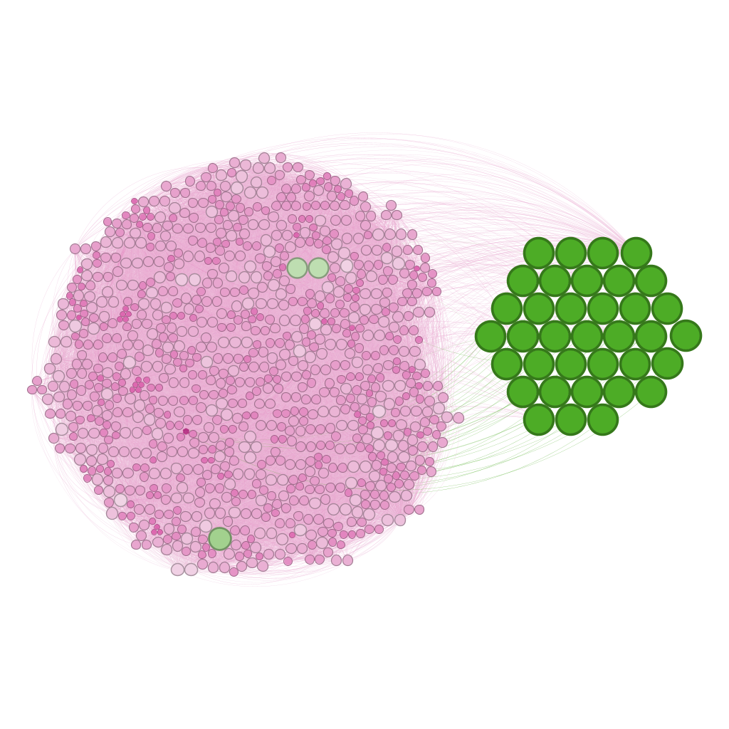
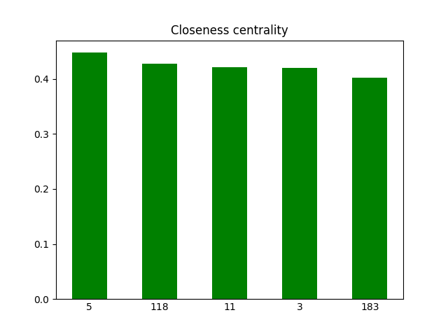
Centralities
Closeness centrality

Slide 18
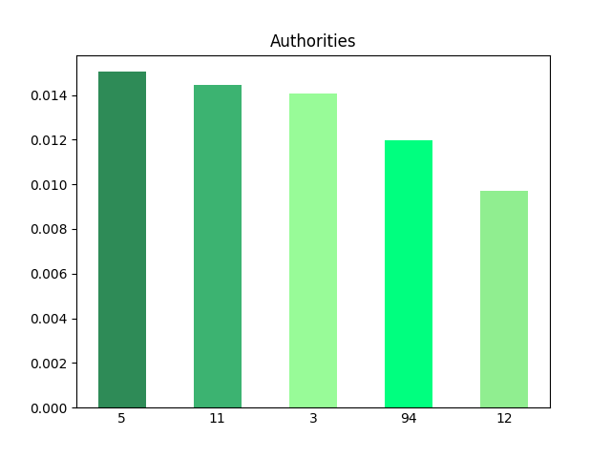
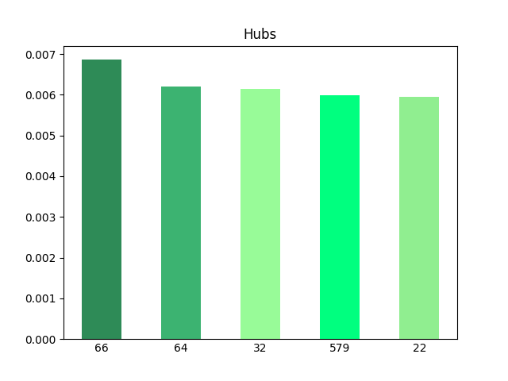
Centralities
Authorities and Hubs

Slide 19
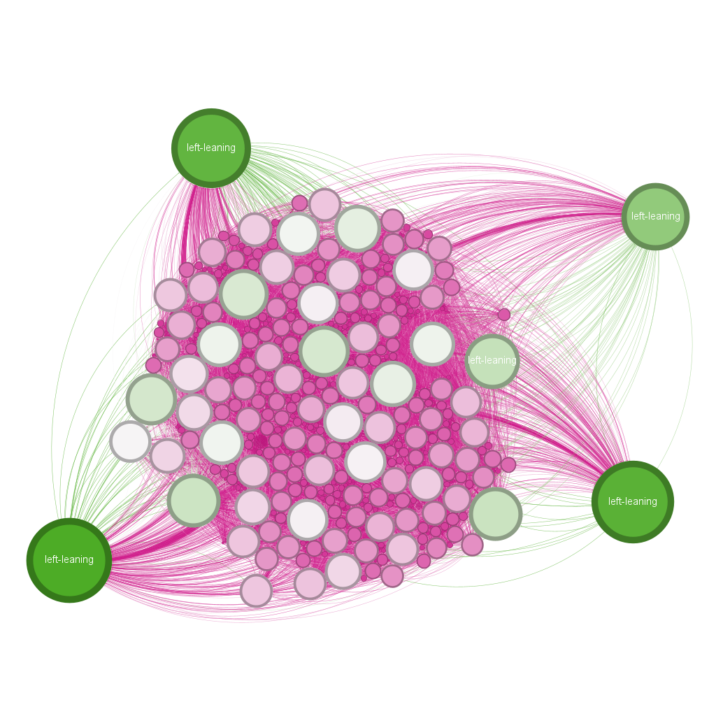
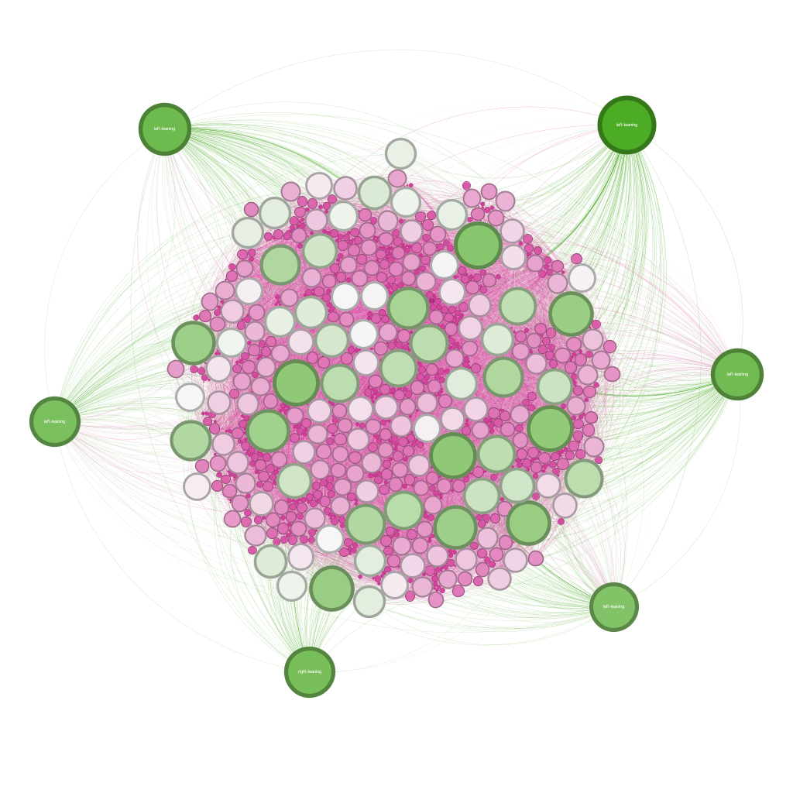
Centralities
Authorities and Hubs

Slide 20
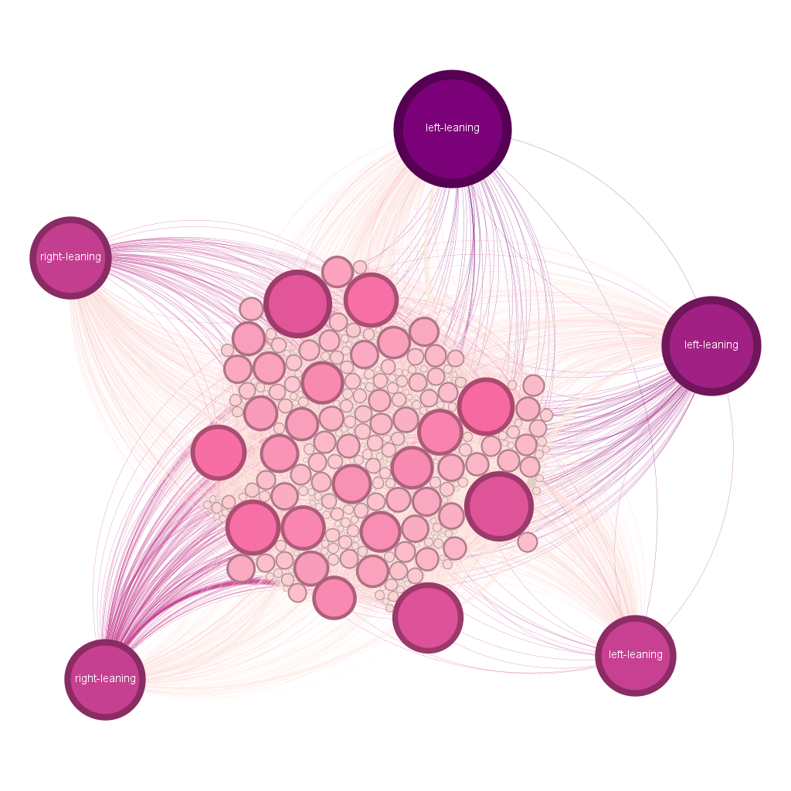
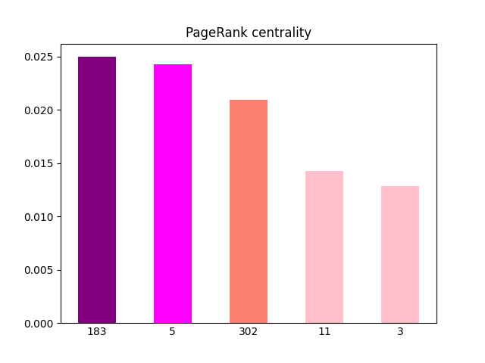
Centralities
PageRank centrality

Slide 21
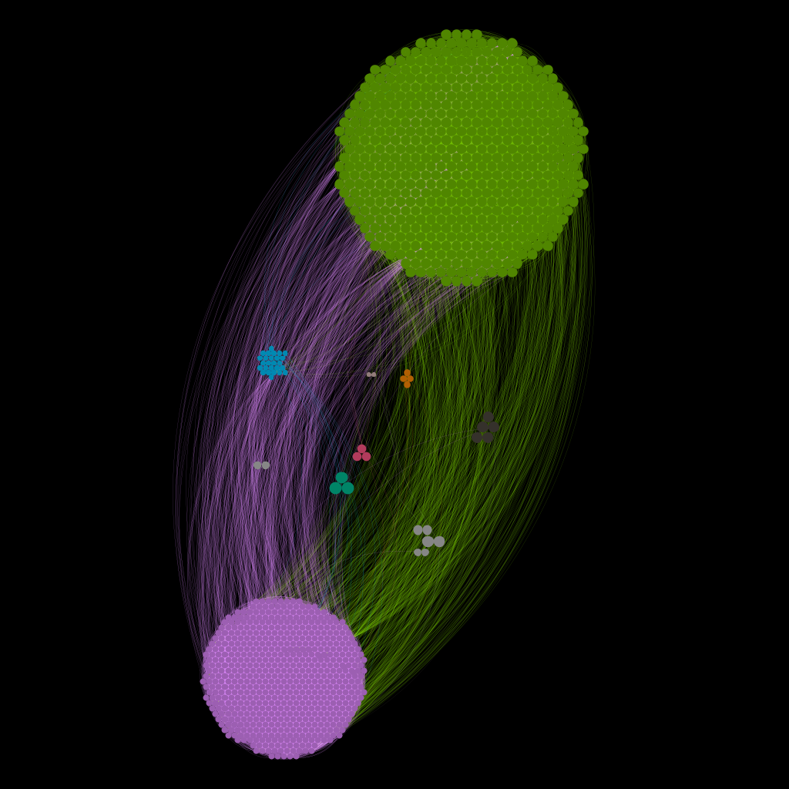
Community analysis
Modularity optimization
The Louvain method was used for this analysis
The network has 12 communities
The modularity is equal to 0.450
The first seven communities have different colors

Slide 22
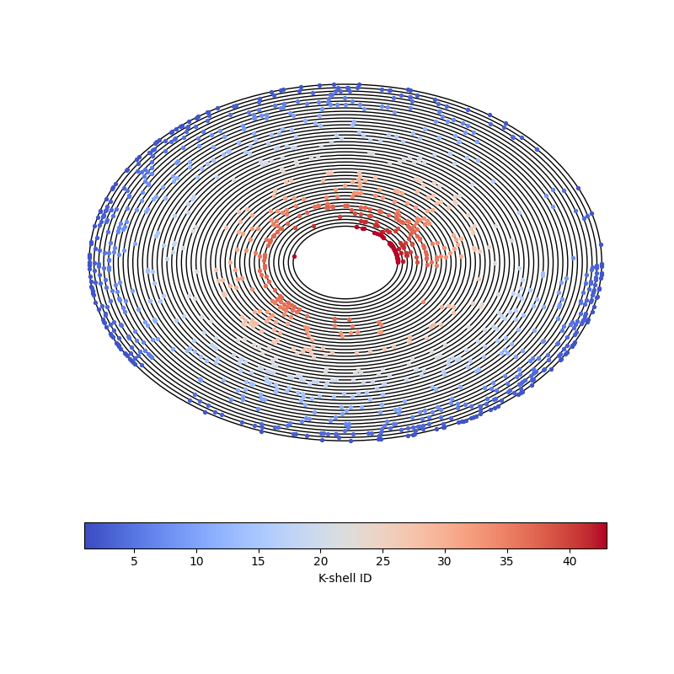
Core-periphery analysis
K-core (k-shell) decomposition
The number of k-shells is equal to 43
The first circle corresponds to the 43th shell
The coldest colors are equal to the first shells while the warmest are equal to the last ones

Slide 23
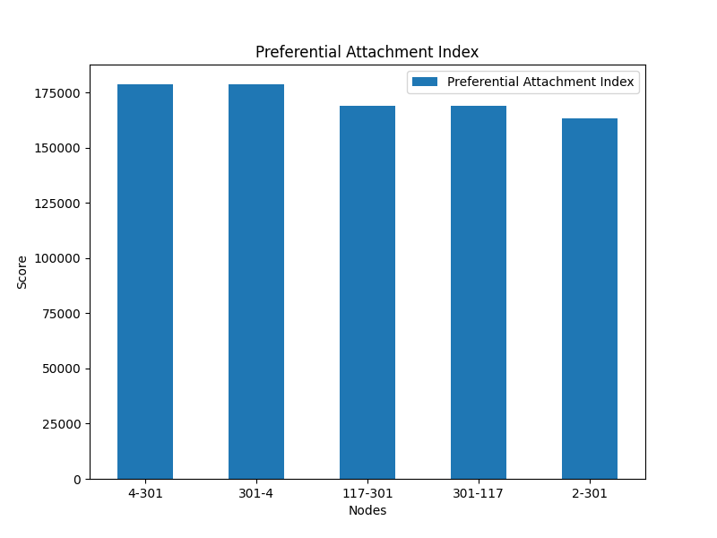
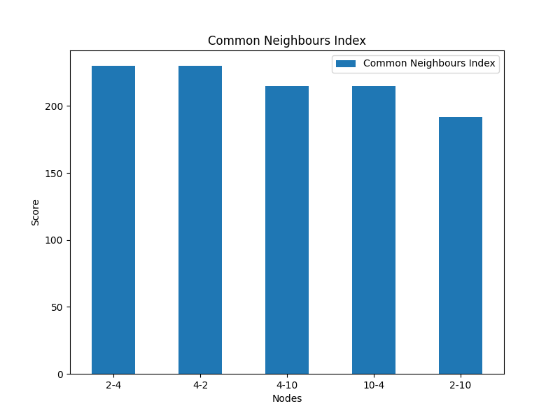
Advanced topics in network analysis
Link prediction

Slide 24
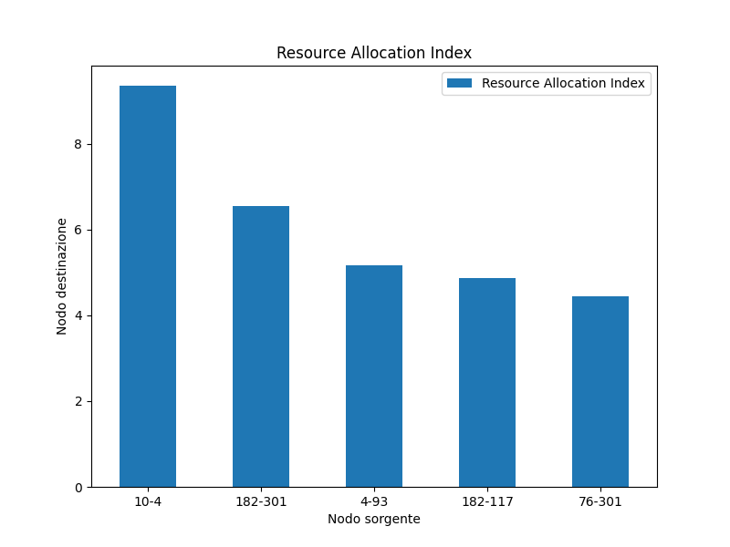
Advanced topics in network analysis
Link prediction

Slide 25
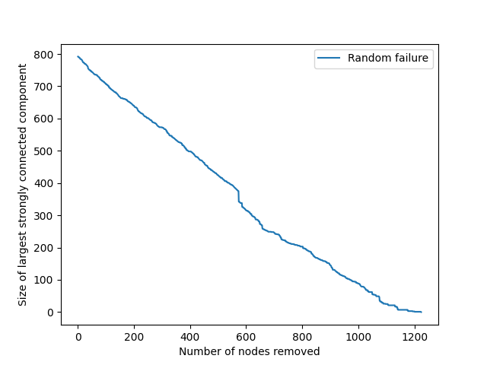
Robustness
Failures
Initially the size of the scc is 743
The trend of the straight line leads us to think that it is a scale free network

Slide 26
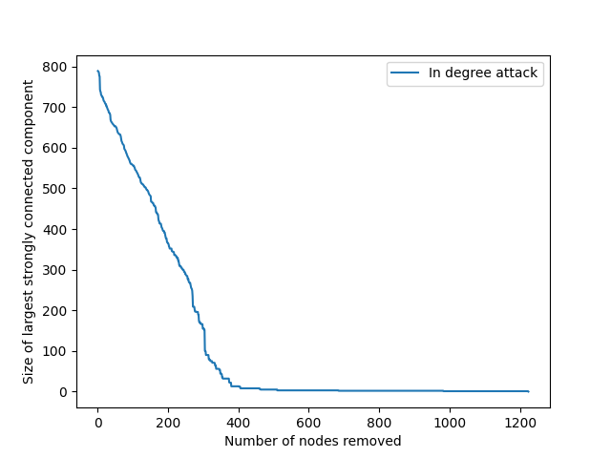
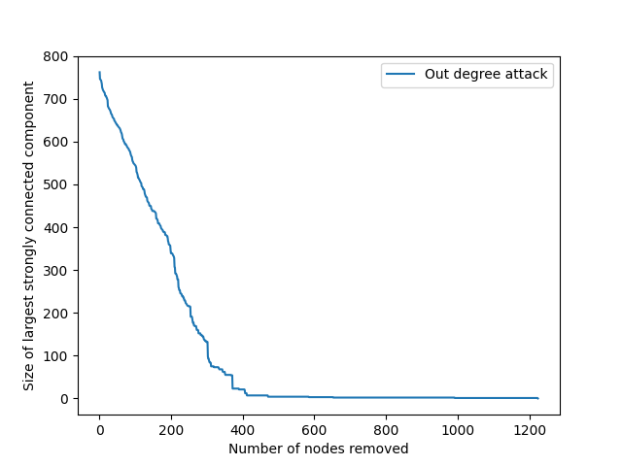
Robustness
Attack

Slide 27

Robustness
Attack
As can be seen from the trend of the various lines following the attacks, the network appears to be of the scale-free type

Slide 28
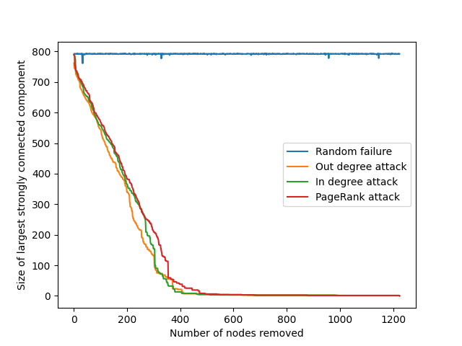
Robustness

